Slide 1
AI Applications in Marketing & Finance
Business Applications of ML
Kartik Hosanagar, Professor of Operations, Information and Decisions

Slide 2

What are Recommender Systems?
Recommender systems use data on purchases, product ratings, and user profiles to predict which products are best suited to a particular customer
Most common design is a collaborative filter
“Customers who bought this item also bought…”
“People like you bought…”
Recommender systems are valuable for both customers and firms
Value to Customers
Value to Firms
Learn about new products
Sort through a myriad of choices
Convert browsers to buyers
Cross-sell
Increase loyalty

Slide 3


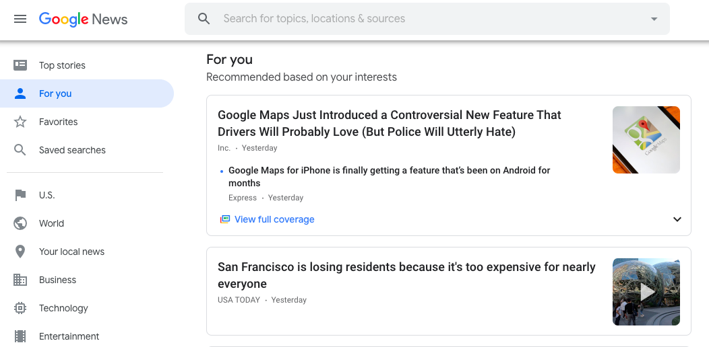
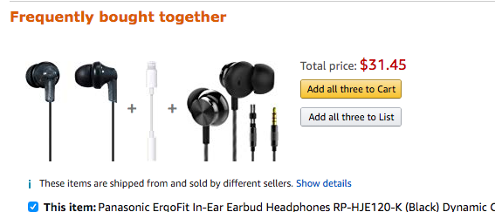
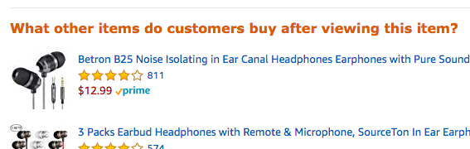

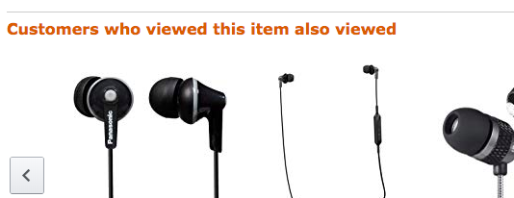
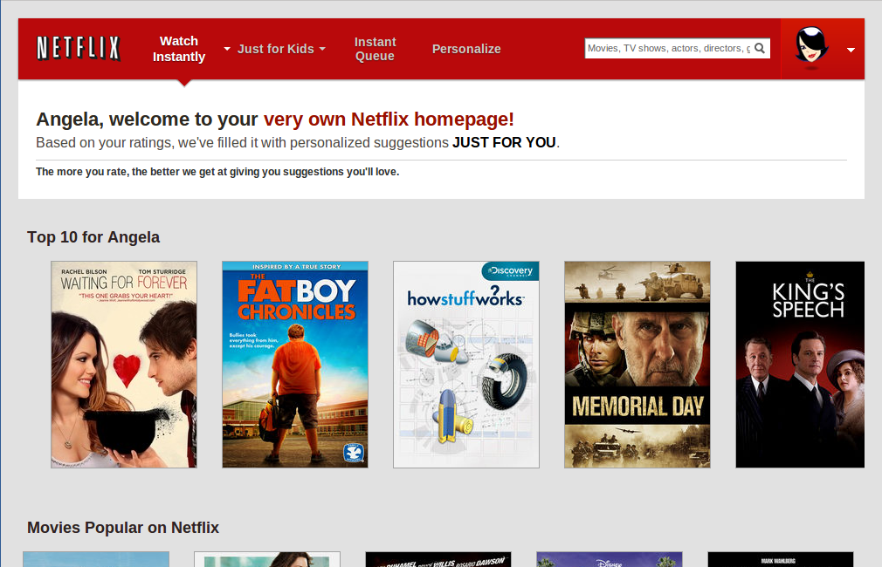
Recommender System Examples
Images: Screenshots from Amazon.com and Google news, https://www.techhive.com/article/2024221/netflix-adds-personalized-profiles-with-recommendations-for-your-entire-household.html

Slide 4

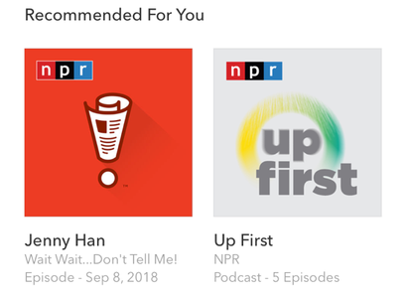

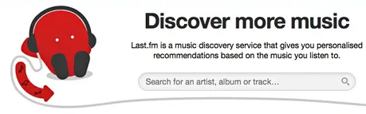
Two Main Recommender Designs
Content-Based Recommenders
Find other products with similar attributes
Pandora
Collaborative Filtering (CF)
Use information on what others buy/like
“People who bought X also bought Y”
Last.fm, Amazon, Netflix
Images: http://blog.pandora.com/us/introducing-podcasts-on-pandora/, https://www.theguardian.com/media/2014/oct/08/last-fm-made-loss

Slide 5
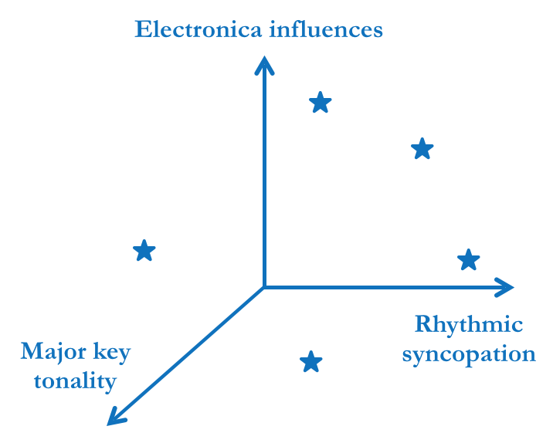
Content-Based Recommender: Pandora
Once you find a song you like, Pandora finds other songs with similar musical qualities
Pandora emerged from the Music Genome Project, so it understands music and can provide explanations using accurate vocabulary
Content/quotes from: “A Human’s Guide to Machine Intelligence” by Kartik Hosanagar

Slide 6
Content-Based Recommender: Pandora
Pandora for Popular Genres
I ask for recommendations based on “Thunder” by Imagine Dragons
Pandora recommends tracks with similar musical qualities and explains why each is acoustically similar to “Thunder”
For example, “Ride” by Twenty One Pilots features “a dub production, a reggae feel, acoustic rhythm piano, use of a string ensemble and major key tonality”
Content/quotes from: “A Human’s Guide to Machine Intelligence” by Kartik Hosanagar

Slide 7
Content-Based Recommender: Pandora
Pandora for Popular Genres
I give one song I disliked a thumbs down
Pandora learns from this feedback & turns towards songs that are less similar to this song
Content/quotes from: “A Human’s Guide to Machine Intelligence” by Kartik Hosanagar

Slide 8
Collaborative Filtering (CF)
Not content-based, but rather based on what others with similar preferences are consuming
Amazon’s “people who bought this also bought…”
Netflix’s original design was also based on CF - it grouped users into “personas” and made suggestions based on users of similar ”personas”
Last.fm for Music Recommendations
I ask for recommendations based on “Thunder” by Imagine Dragons
Last.fm suggests tracks based on what others who like “Thunder” also liked
Last.fm can’t explain further b/c it lacks musical knowledge
Content/quotes from: “A Human’s Guide to Machine Intelligence” by Kartik Hosanagar

Slide 9
Collaborative Filtering (CF): Last.fm
Two types of collaborative filters
Item-to-Item CF - recommends items bought by others who bought the item you are interested in
“People who bought X also bought Y”
User-similarity based CF - recommends items bought by others who are similar to you based on data the company has about your preferences
“People like you like X”
Pros of collaborative filters
Easy and cheap to build (don’t need detailed metadata about products)
Effective in practice
Content/quotes from: “A Human’s Guide to Machine Intelligence” by Kartik Hosanagar

Slide 10
Collaborative Filtering Challenges
Key design trade-offs
Sparse data: How do you decide how similar two users are when the intersection of products they have both used is limited?
They may have each only reviewed a handful of products out of thousands, and may not have reviewed any product in common
 | 1 | 2 | 3 | 4 | 5 | 6 | 7 | 8 | 9
U1 | - | - | - | - | 3 | - | - | - | -
U2 | - | - | - | - | - | - | - | - | 4
Here, U1 and U2 each rated a different product, making it difficult to tell how similar they are.
Cold-start:
How to make recommendations for new users for whom you have no data?
How to handle new items with no reviews or other users?
Content/quotes from: “A Human’s Guide to Machine Intelligence” by Kartik Hosanagar

Slide 11
AI Applications in Marketing & Finance
Personalization: Impacts on Markets
Kartik Hosanagar, Professor of Operations, Information and Decisions

Slide 12
Recommenders and Consumer Choice
28-35% of retail sales at Amazon originate from algorithmic recommendations
38% increase in usage at Google News
80% of video hours streamed on Netflix originate from algorithmic recommendations

Slide 13
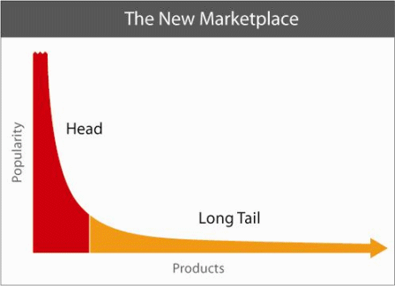
Collaborative Filtering and Sales Diversity
The “Long Tail” concept: popularized by the book The Long Tail
“Suggested that the main effect of automated recommendations would be to help people move from the world of hits to the world of niches- obscure products that are closer to our individual preferences but never get our attention in mainstream markets”
But given that CF algorithms recommend items based on what others are consuming, do they really increase sales diversity?
Source: Longtail.com
Content/quotes from: “A Human’s Guide to Machine Intelligence” by Kartik Hosanagar

Slide 14
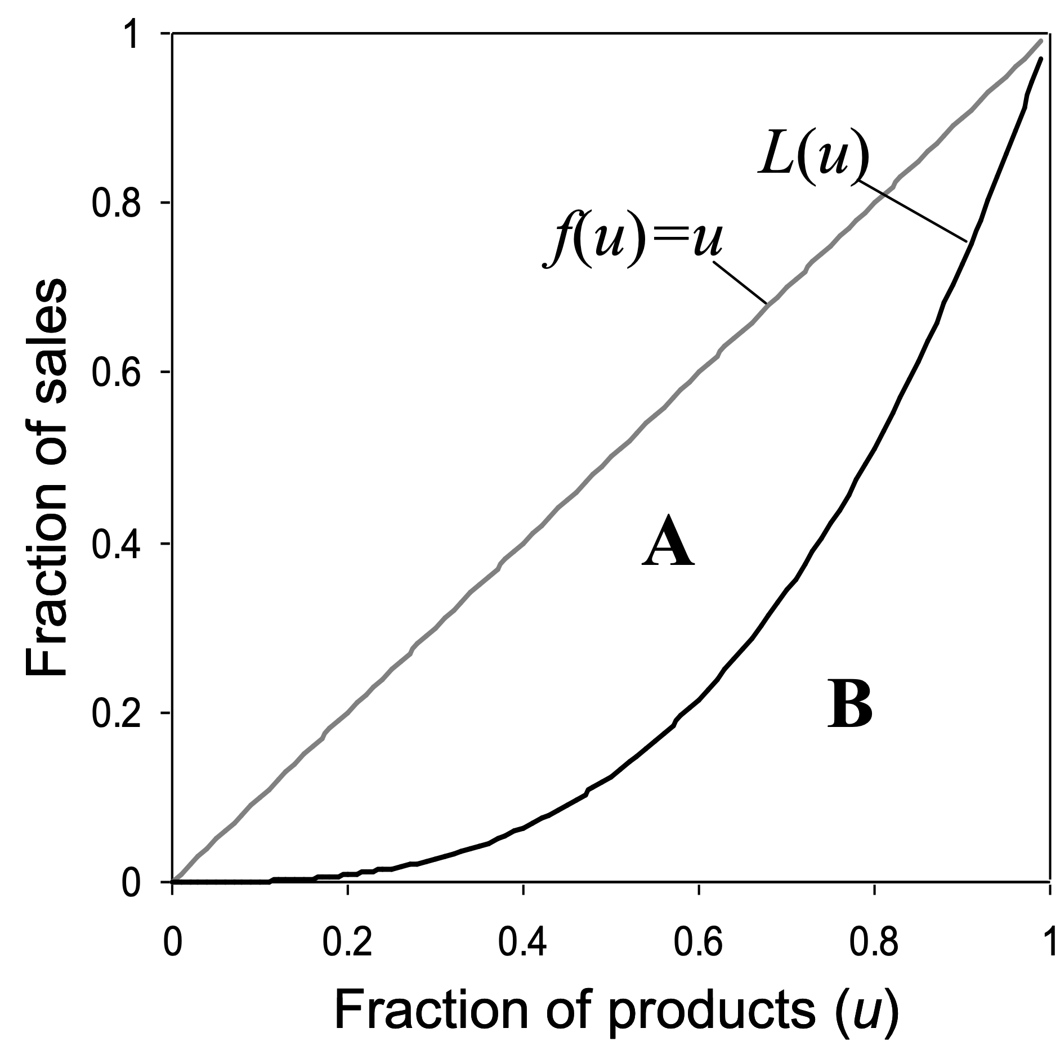
Measuring Diversity: Gini Coefficient
G = A/(A+B) Closer to 0 = Equality Closer to 1 = Inequality
Content/quotes from: “A Human’s Guide to Machine Intelligence” by Kartik Hosanagar

Slide 15
Problem Statement
G0 = Gini without recommendations
Gi = When recommender ri is employed, all else equal
{
Diversity
Concentration
Neutral
Gi < G0
Gi > G0
Gi = G0
Bias of ri

Slide 16
Empirical Evidence
Field experiment on a top retailer website
August 8, 2013 and August 22, 2013
A/B test with visitors given unique IDs and all behavior tracked over time
1,138,238 users randomly assigned into 3 groups:
Control (77%)
View-Based Collaborative Filtering (11.5%)
“People who viewed this item also viewed”
Purchase-Based Collaborative Filtering (11.5%)
“People who purchased this item also purchased”

Slide 17
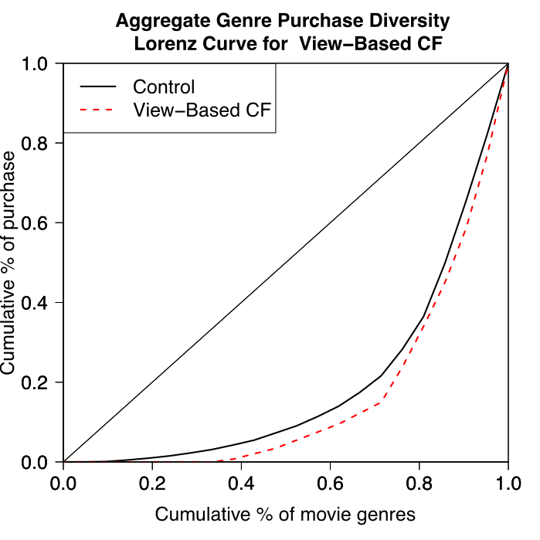
Sales Diversity of Movies*
 | Control | View-based CF
Gini | 0.60 | 0.68
Change | p-value |  | 0.07 | (0.004)
*Results are directionally similar for all other product categories on the website

Slide 18
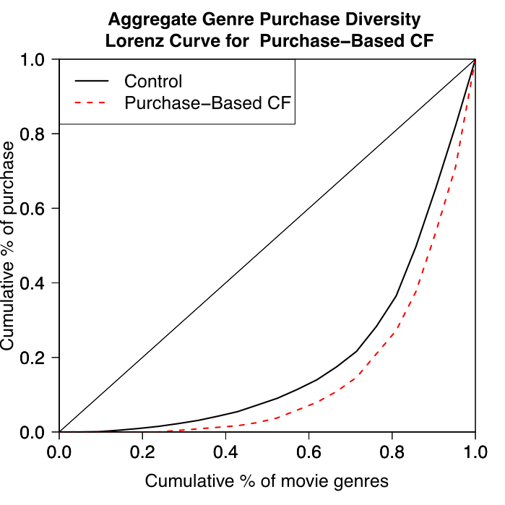
Sales Diversity of Movies*
 | Control | View-based CF
Gini | 0.60 | 0.70
Change | p-value |  | 0.10 | (< 0.0041)
*Results are directionally similar for all other product categories on the website

Slide 19
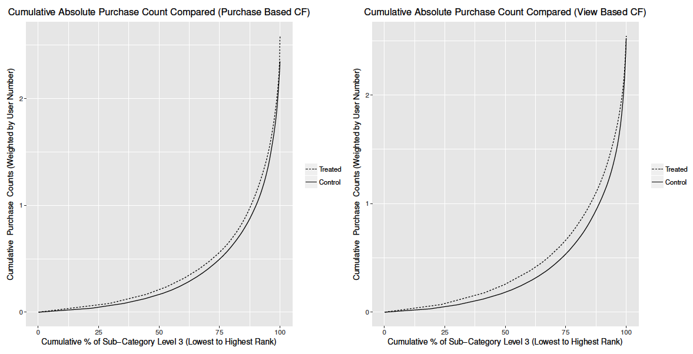
Absolute Sales of Niche Items

Slide 20
Absolute Sales of Niche Items
Even though the market share of niche items decreases after the firm rolled out traditional collaborative filtering algorithms, the absolute sales of niche items in fact increases
That is, all products – niche and popular – sell more under collaborative filters
But popular products gain much more than niche products, resulting in their market share further increasing

Slide 21
AI Applications in Marketing & Finance
Personalization: Addressing the Challenges
Kartik Hosanagar, Professor of Operations, Information and Decisions

Slide 22
Trade-offs of Different Recommender Designs
Collaborative Filtering
Content-Based Recommenders
PROS
PROS
No need for detailed metadata
Helps users discover new items
Knowing that others “like you” like an item can itself be convincing
Doesn’t have popularity bias
Provides relevant suggestions
Can explain recommendations
Works relatively well even for less popular/newer items with less data as well as for new users
CONS
Has a popularity bias
Can’t explain recommendations
Has difficulty with less popular items that have less data
Cold-start issue (new items)
CONS
Difficult to build because you need detailed metadata
Content/quotes from: “A Human’s Guide to Machine Intelligence” by Kartik Hosanagar

Slide 23
Hybrid Recommender: Spotify
Spotify Discover uses a hybrid design and addresses the difficulty of needing detailed metadata by applying ML to automate this process
To gain the knowledge of a content-based recommender, Spotify:
Crawls the web to examine blog posts and online discussions to figure out the kind of descriptive language that listeners use to discuss songs/artists
It then uses these terms for attributes of songs
When there is less data/discussion about newer and niche songs online:
Spotify uses ML to analyze the audio signal of a song and extract characteristics like tempo, loudness, key & tonality
Spotify Discover combines the best of both types of recommenders, uses ML to automate the work of building the system’s musical knowledge, avoids a popularity bias, and is very well liked by users
Content/quotes from: “A Human’s Guide to Machine Intelligence” by Kartik Hosanagar

Slide 24
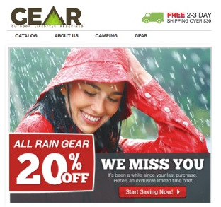
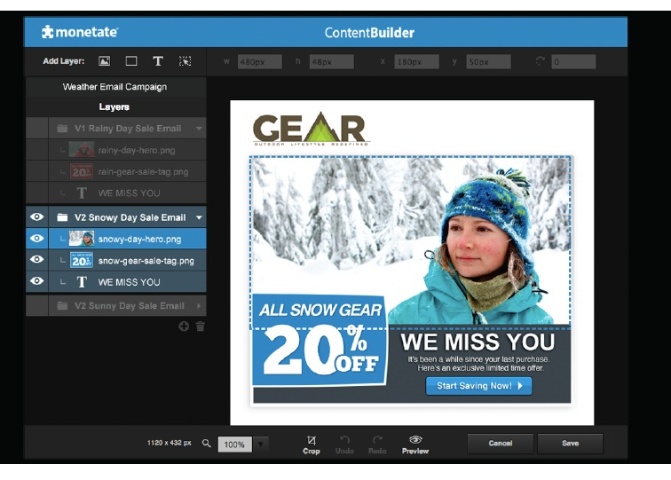
Personalization: More than Recommendations
Personalization is not limited to product recommendations
It is about holistically adjusting communications with customers based on customer characteristics (e.g. websites or emails tailored to individual users)
If you know a customer is located in Seattle, you might send them an ad for rain gear, while a customer in Boston may get one for snow gear

Slide 25
Risks of Personalization
Misapplication
Making sweeping generalizations
Data privacy concerns
It isn’t always effective to remind customers how much info you have on them
Crossing the “creepy” line
I may not want a website to remember that I’ve bought weight loss products or smoking-cessation products
Regulatory compliance
Respect laws regarding data privacy in multiple jurisdictions

Slide 26
AI Applications in Marketing & Finance
Interview with Apoorv Saxena
Kartik Hosanagar, Professor of Operations, Information and Decisions

Slide 27
AI Applications in Marketing & Finance
Machine Learning in Finance: Fraud Detection
Kartik Hosanagar, Professor of Operations, Information and Decisions

Slide 28



Credit Card Fraud
Fraud Occurs
Customer Impacted
Dispute Required
Card Replaced
Content/quotes from “Prediction Machines: The Simple Economics of Artificial Intelligence ” by Ajay Agrawal, Avi Goldfarb, and Joshua Gans
Images: https://visualmodo.com/6-security-tips-protect-ecommerce-site/, https://icons8.com/icons/set/phone, https://www.vecteezy.com/vector-art/383180-illustration-of-scissors-cutting-a-credit-card

Slide 29
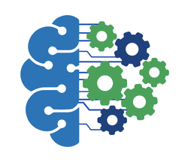
Credit Card Fraud
Fraud Occurs
ML Detects
Customer Impact Avoided
Card Replaced
Early fraud detection with ML can help prevent fraud and save banks a lot of money
Content/quotes from: “A Human’s Guide to Machine Intelligence” by Kartik Hosanagar, Images: https://visualmodo.com/6-security-tips-protect-ecommerce-site/, https://medium.com/@fenjiro/data-mining-for-banking-loan-approval-use-case-e7c2bc3ece3, https://icons8.com/icons/set/phone, https://www.vecteezy.com/vector-art/383180-illustration-of-scissors-cutting-a-credit-card

Slide 30
ML Model Accuracy is Crucial
False negatives occur when a business does not detect a transaction as fraudulent and allows the fraudster to make a purchase
The actual cardholder discovers the charge, disputes it, and is usually repaid by the bank
The merchant/bank is responsible for both the cost of the item sold to the fraudster and the associated dispute fees
False positives occur when a transaction is flagged as fraudulent and blocked, although the potential purchase was actually not fraud
Has an indirect impact by causing reputational damage (this customer may not return; others may hear about people being blocked)
Directly impacts gross profits (loss of this purchase)
Content/quotes from: https://stripe.com/radar/guide

Slide 31
Machine Learning Opportunity
Both supervised and unsupervised learning are used in fraud
Supervised Learning
Unsupervised Learning
Training occurs by using a large dataset with the details of individual transactions provided and with each transaction tagged as fraud or not
From this, the model learns the unique patterns of fraud
Anomaly detection can compare new transactions with prior ones to detect outliers
This can help identify fraud that doesn’t necessarily fit a previously identified pattern (e.g. a new type of fraud)
Content/quotes from: https://stripe.com/radar/guide & https://www.fico.com/blogs/5-keys-using-ai-and-machine-learning-fraud-detection

Slide 32
Supervised Learning Example
Requires input data for training (usually historical data of two types):
“Properties that can be ‘read off’ a single credit card payment
Country the card was issued in, IP address of payment, user’s email domain, etc.
Behavioral data (provides “some of the most predictive signals”)
Number of countries the card was used recently
Content/quotes from: https://stripe.com/radar/guide

Slide 33
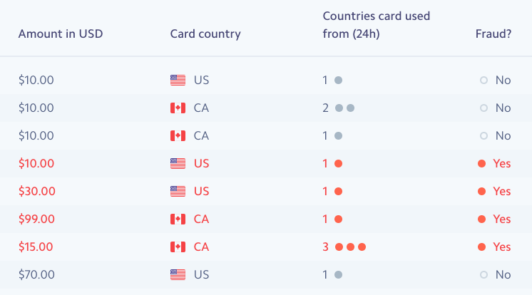
Supervised Learning Example (cont.)
Requires input data for training (usually historical data of two types):
“Properties that can be ‘read off’ a single credit card payment
Behavioral data (provides “some of the most predictive signals”)
Sample Training Data*
* This training data is very limited in order to provide a simple example
To build an accurate model you would need millions of rows as well as additional columns
Content/quotes from: https://stripe.com/radar/guide

Slide 34
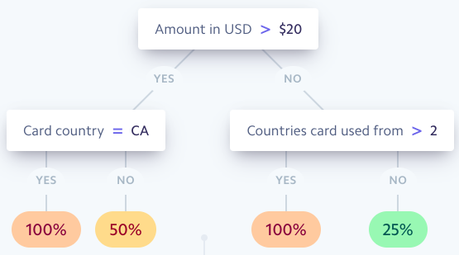
Supervised Learning Example (cont.)
Produces an output model, such as the following decision tree
The tree answers: “of transactions in our data set with properties similar to the transaction we’re examining now, what fraction were actually fraudulent?”
“The machine learning part is concerned with the construction of the tree - what questions do we ask, in what order, to maximize the chances that we can distinguish between the two classes accurately?”
Sample Output*
*This decision tree is based on the same limited data from the previous slide
Content/quotes from: https://stripe.com/radar/guide

Slide 35
Supervised Learning Example (cont.)
Produces an output model, such as the following decision tree
The tree answers: “of transactions in our data set with properties similar to the transaction we’re examining now, what fraction were actually fraudulent?”
“The machine learning part is concerned with the construction of the tree - what questions do we ask, in what order, to maximize the chances that we can distinguish between the two classes accurately?”
Sample Output*
*This decision tree is based on the same limited data from the previous slide
Content/quotes from: https://stripe.com/radar/guide

Slide 36
Supervised Learning Example (cont.)
Produces an output model, such as the following decision tree
The tree answers: “of transactions in our data set with properties similar to the transaction we’re examining now, what fraction were actually fraudulent?”
“The machine learning part is concerned with the construction of the tree - what questions do we ask, in what order, to maximize the chances that we can distinguish between the two classes accurately?”
Sample Output*
*This decision tree is based on the same limited data from the previous slide
Content/quotes from: https://stripe.com/radar/guide

Slide 37
Supervised Learning Example (cont.)
Produces an output model, such as the following decision tree
The tree answers: “of transactions in our data set with properties similar to the transaction we’re examining now, what fraction were actually fraudulent?”
“The machine learning part is concerned with the construction of the tree - what questions do we ask, in what order, to maximize the chances that we can distinguish between the two classes accurately?”
Sample Output*
*This decision tree is based on the same limited data from the previous slide
Content/quotes from: https://stripe.com/radar/guide

Slide 38
Machine Learning Fraud Detection
Supervised Learning: From this (very limited) data, the model would learn a unique pattern of fraud
If >$20 & from Canada, 100% chance of fraud
If <$20 & from >2 countries, 100% chance of fraud
If >$20 & not from CA, or <$20 & from <2 countries, not sure
Unsupervised Learning: Detecting transactions that appear like anomalies
A transaction is for an exceptionally high amount + in a country where this person has not transacted before + in the past, foreign transactions were preceded by flight purchase to that country unlike this time = Anomaly
Content/quotes from: https://stripe.com/radar/guide

Slide 39
Advantages of ML for Fraud
Speed
Scale
Efficiency
Algorithms can quickly process a large volume of transactions
This is important for fraud since a decision is needed in real time
A challenge for humans, but algorithms improve as the amount of data increases.
Machine learning algorithms are better than humans at repetitive tasks
Content/quotes from: https://marutitech.com/machine-learning-fraud-detection/

Slide 40
Limitations of ML for Fraud
Transparency
Data Volume
Algorithms can’t always explain why someone was blocked
Hard to catch issues with the model if it isn’t well understood
Also an ethical problem if biases go undetected (to be discussed in Module 4)
Smaller companies may not have enough training data
Algorithm accuracy might be lower as a result
Content/quotes from: https://marutitech.com/machine-learning-fraud-detection/

Slide 41
AI Applications in Marketing & Finance
Machine Learning in Finance: Additional Applications
Kartik Hosanagar, Professor of Operations, Information and Decisions

Slide 42
Identity Verification & Authentication
ML can improve security through more than just detecting fraud patterns, and it also provides new methods of improving identity verification
Traditional Verification
ML-Based Verification
Passwords
PIN numbers
Biometric authentication using facial and voice recognition technologies
One biometric use case would be when new accounts are opened and customers need to provide multiple forms of ID
Customers could instead provide “selfies” or voice prints, facial recognition and voice recognition technologies can be used to verify identity based on the images/audio provided
ATMs in China are starting to use face recognition
Content/quotes from “Section 2: Known Applications of AI”

Slide 43
Identity Verification & Authentication (cont.)
Biometric authentication can also occur continuously and without intruding into the customer experience - it involves verifying customers’ identities while they are already engaging with the bank through mobile apps
E.g. AI can detect unique biometric patterns of individual customers:
How the person naturally holds a mobile device
How the person taps the screen
Content/quotes from “Section 2: Known Applications of AI”

Slide 44
Identity Verification & Authentication (cont.)
Key Benefits & Limitations of ML for Identity Verification
Benefits
Limitations
Improved security, potentially without creating a cumbersome experience for customers
Not fool proof - attackers could still access biometric identifiers and pose as customers
However, it can still deter attackers
Content/quotes from “Section 2: Known Applications of AI”

Slide 45
Loan & Insurance Underwriting
ML can detect patterns between consumer data and loan or insurance outcomes, and use this to predict the outcomes of particular applicants
E.g., Supervised learning can be used by providing a training dataset with historical data on consumers and their lending/insurance results
Consumer data: age, income, employment, etc.
Lending/insurance results: repaying loans on time vs. defaulting
Content/quotes from: “Section 2: Known Applications of AI”
Additional Content from: https://emerj.com/ai-sector-overviews/machine-learning-in-finance/

Slide 46
Loan & Insurance Underwriting (cont.)
Key Benefits & Limitations of Loans/Insurance Models
Benefits
Limitations
Could reduce processing time
Potential for “increasing loan volume & reducing risk…[by] using more diverse data as well as data with weaker signals.”
Algorithm could be biased and could perpetuate historical discrimination
Companies need to make sure their algorithms don’t discriminate (discussed further in Module 4)
Content/quotes from: “Section 2: Known Applications of AI”
Additional Content from: https://emerj.com/ai-sector-overviews/machine-learning-in-finance/

Slide 47
Predicting Customer Churn
Banks want to retain customers/prevent churn and can apply ML to this goal
In much the same way as with fraud models, the customer data that banks have can be used to “create churn models based on customer attributes or features of those who did or did not churn for another competitor”
Key Benefits & Limitations of Churn Models
Benefits
Limitations
Predictions from churn models are actionable b/c knowing in advance which customers might churn allows banks to make extra efforts to improve those customers’ satisfaction
Predictions about who might churn don’t necessarily provide insight into what is causing them to leave and how best to retain them
Content/quotes from “Section 2: Known Applications of AI”

Slide 48
Three Additional Examples of ML in Finance
Customer Experience
Conversational AI platforms are being used to service customers via chat or over the phone to improve responsiveness and reduce costs
Personal Finance
Personalized portfolios
Financial Forecasting
Ability to predict company financials or budgeting needs in the future
Content/quotes for financial forecasting from “Section 2: Known Applications of AI”
Content/quotes for customer experience and personal finance section from https://www.alacriti.com/machine-learning-in-financial-services-potential-applications/

Slide 49


